Slide 1

Security
Lecture 1: Introduction
R. Brooks

Slide 2
Security
Vs
Safety

Slide 3
Danger
Risk
Security

Slide 4


Slide 5


Slide 6
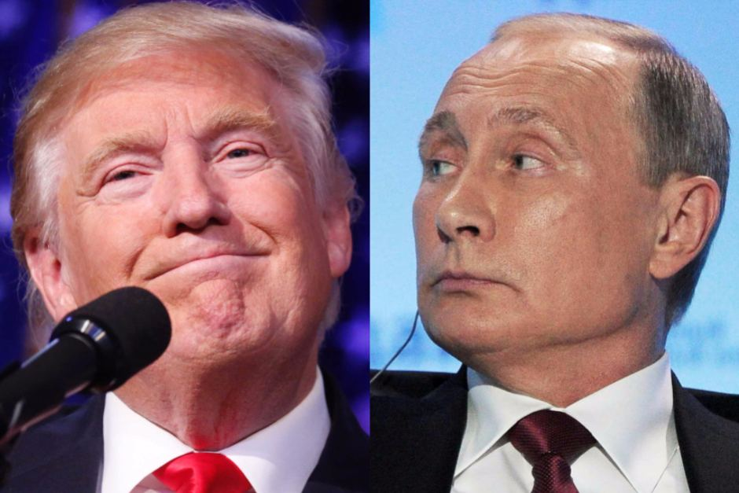

Slide 7
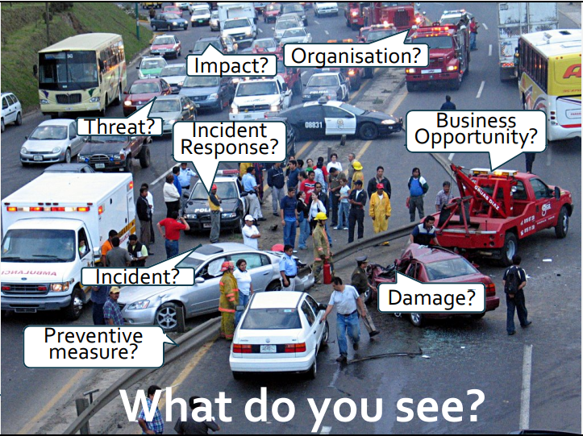

Slide 8
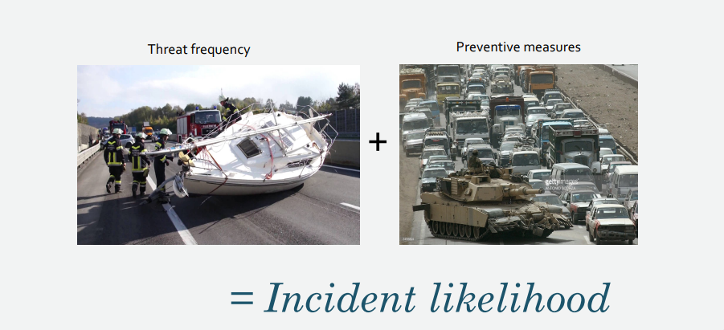

Slide 9
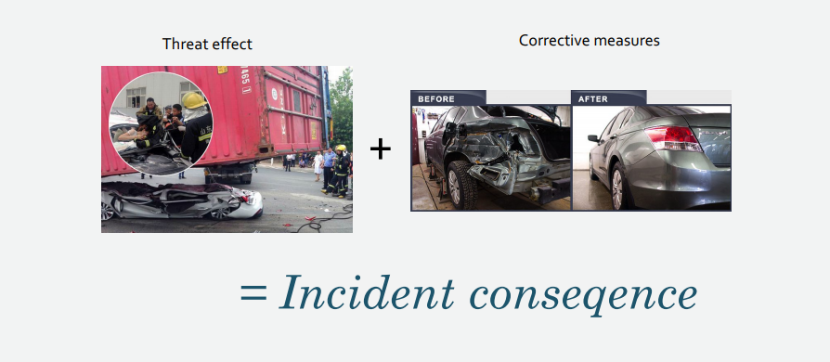

Slide 10
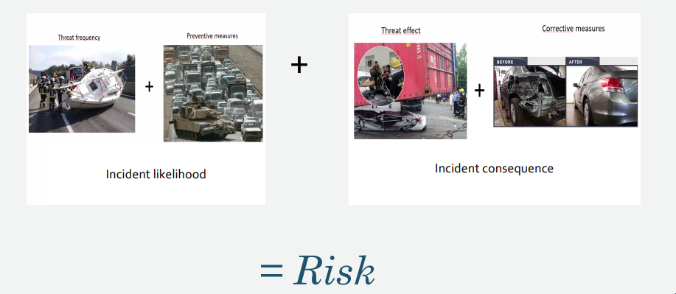

Slide 11
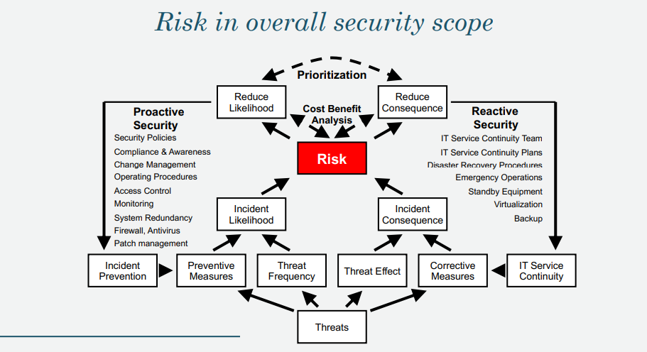

Slide 12
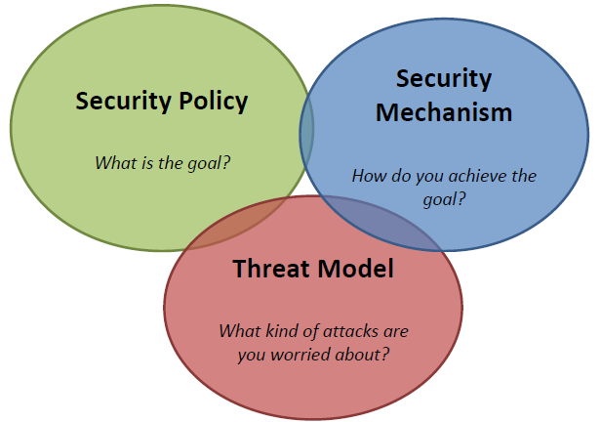
Security Methodology

Slide 13
Security Methodology
We setup security policies and state our objectives
We implement security mechanisms against
The threats which we have identified

Slide 14
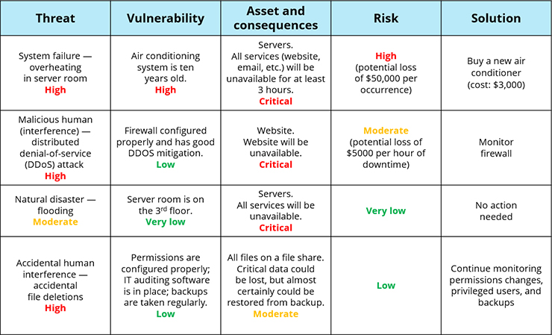

Slide 15
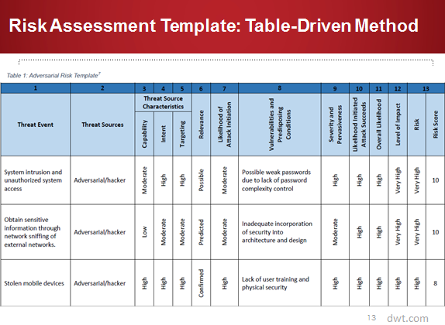

Slide 16
Create or find your own model to use in your project based on what we go through in the next 5 weeks

Slide 17
Computer Security Objectives
Confidentiality
Data confidentiality
Assures that private or confidential information is not made available or disclosed to unauthorized individuals
Privacy
Assures that individuals control or influence what information related to them may be collected and stored and by whom and to whom that information may be disclosed
Integrity (incl. Authenticity + Accountability)
Data integrity
Assures that information and programs are changed only in a specified and authorized manner
System integrity
Assures that a system performs its intended function in an unimpaired manner, free from deliberate or inadvertent unauthorized manipulation of the system
Availability
Assures that systems work promptly and service is not denied to authorized users

Slide 18
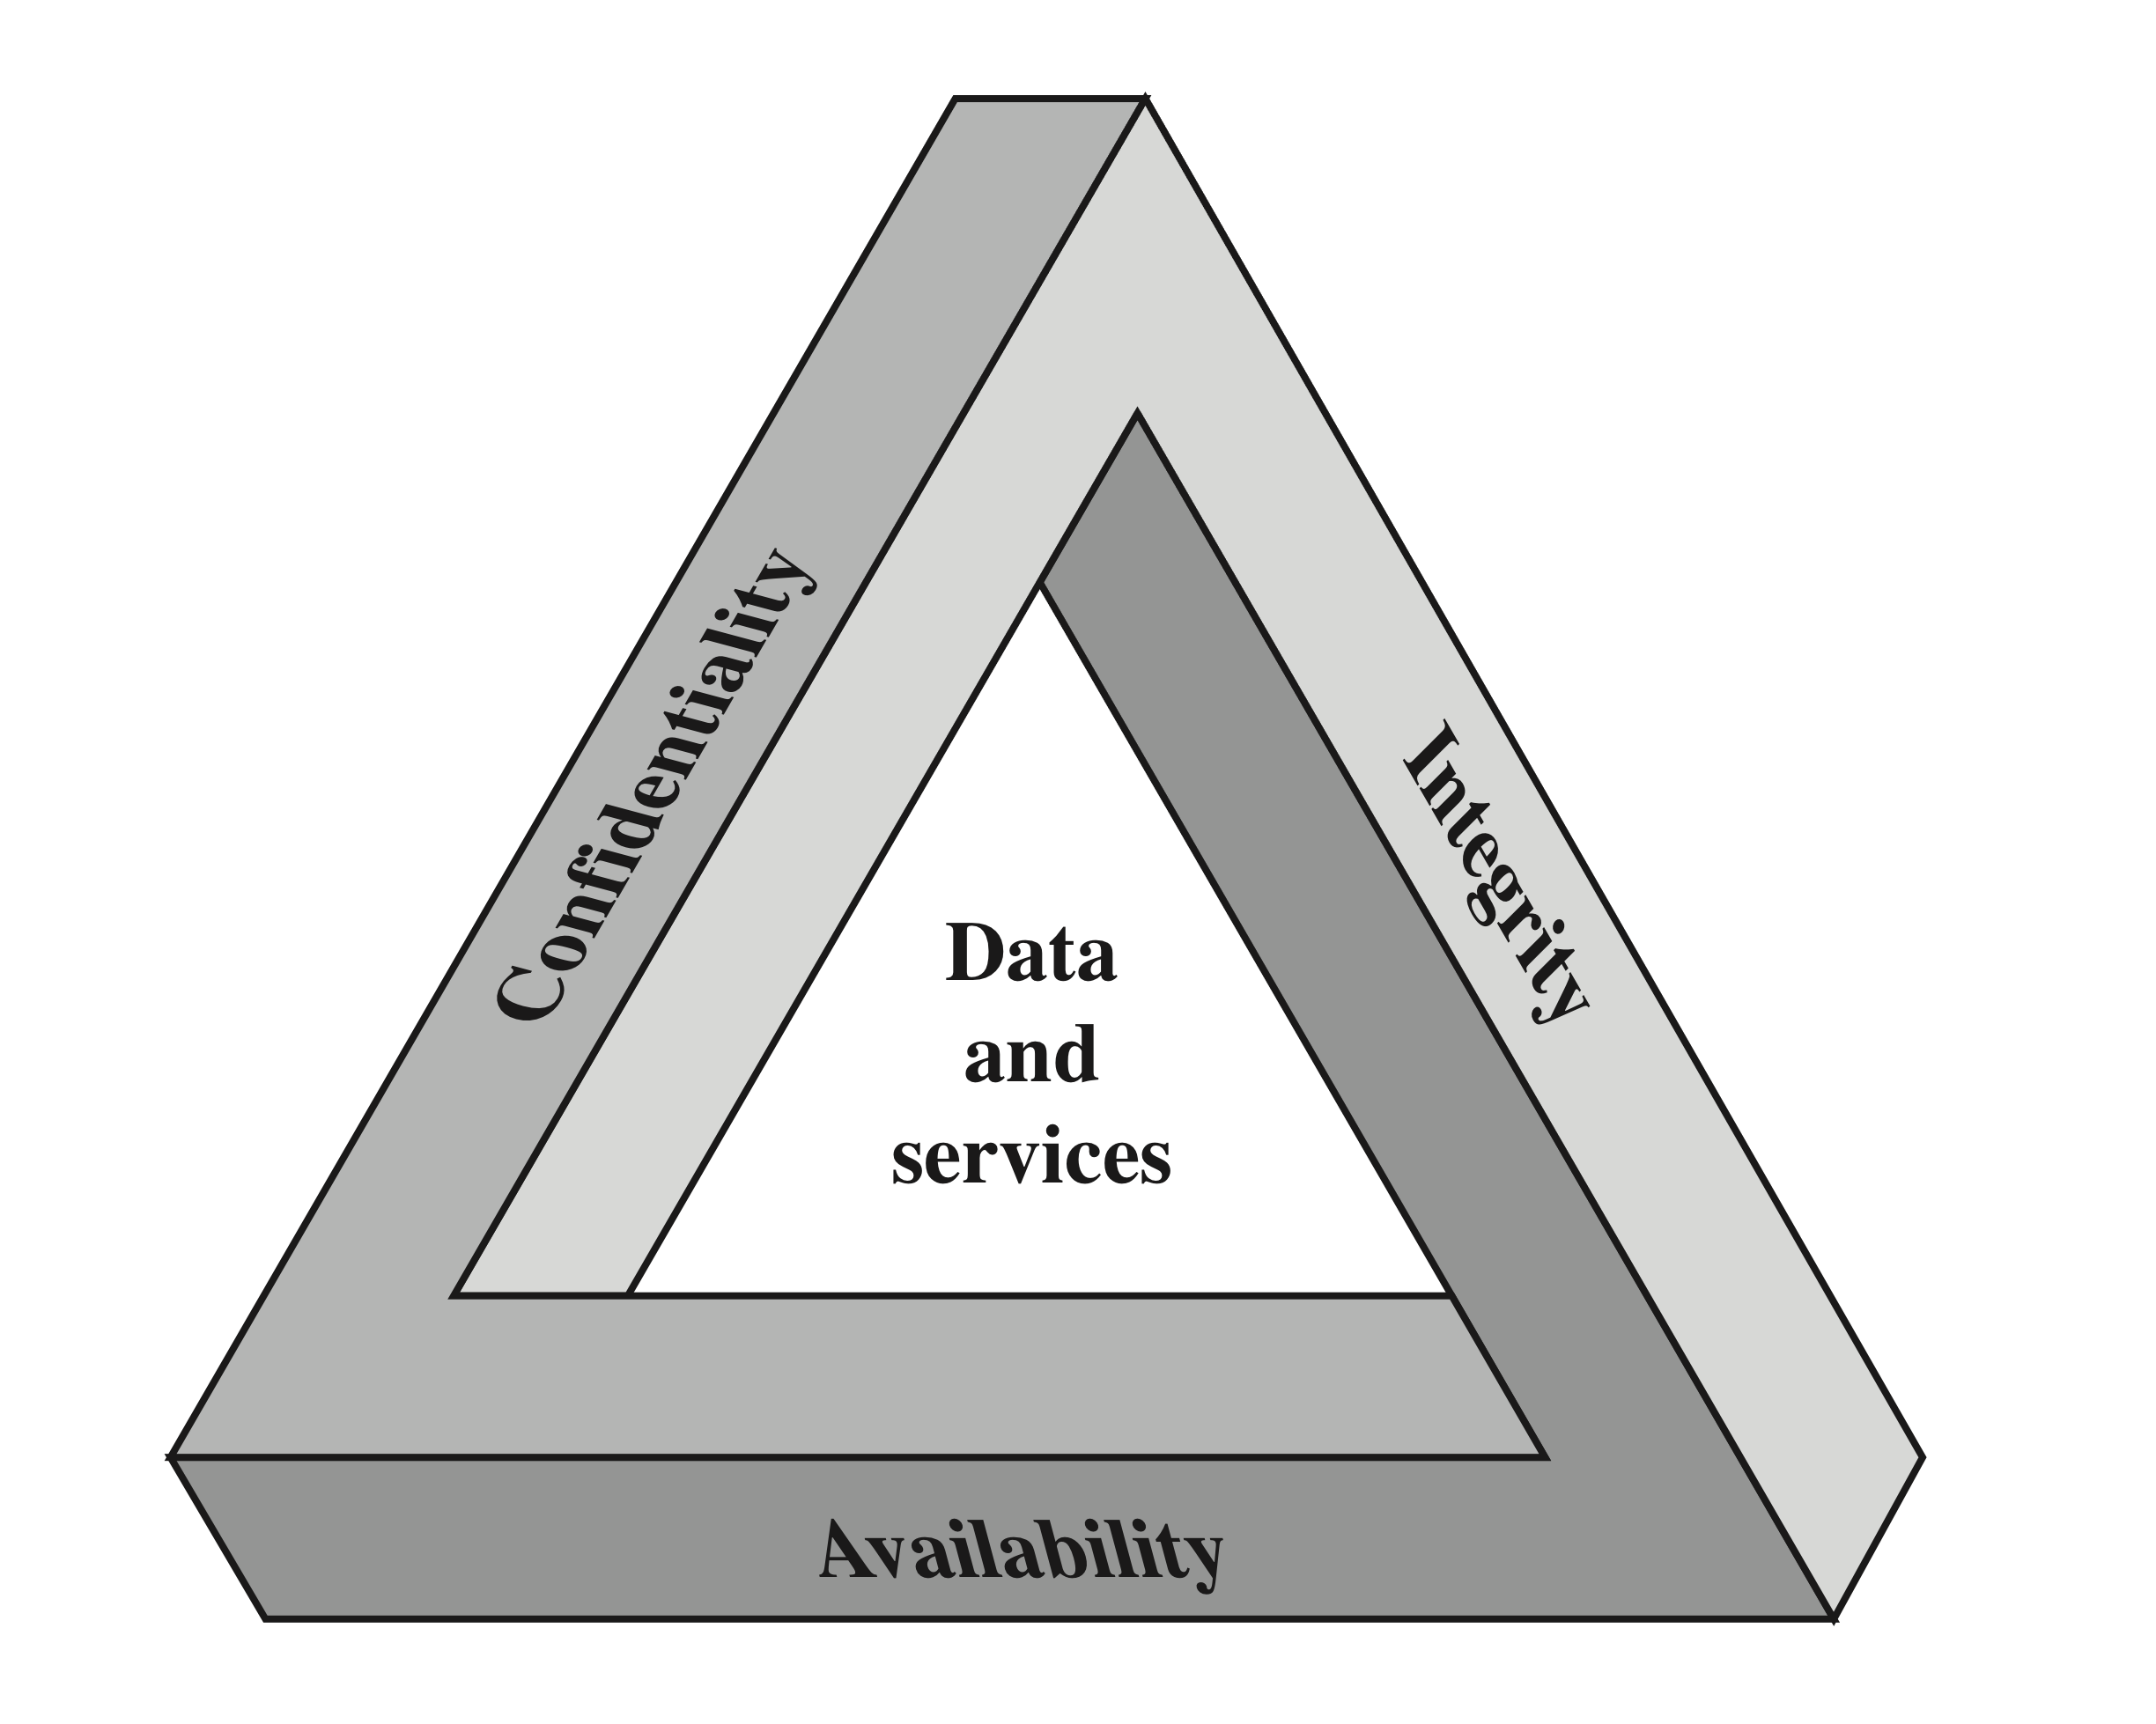
CIA Triad
We want systems where information does not leak to people that should not have access. This applies at any time, i.e., whether
the data is being stored, processed or transmitted.
We want that the data in our systems are authentic, i.e.,
have not been tampered with by people not authorized to do so. Also a user should not be fooled into believing that a document comes
from a particular source when this is not the case.
We want systems that work when they are supposed to, i.e., legal users of the system should be able to get their data when they need them.

Slide 19
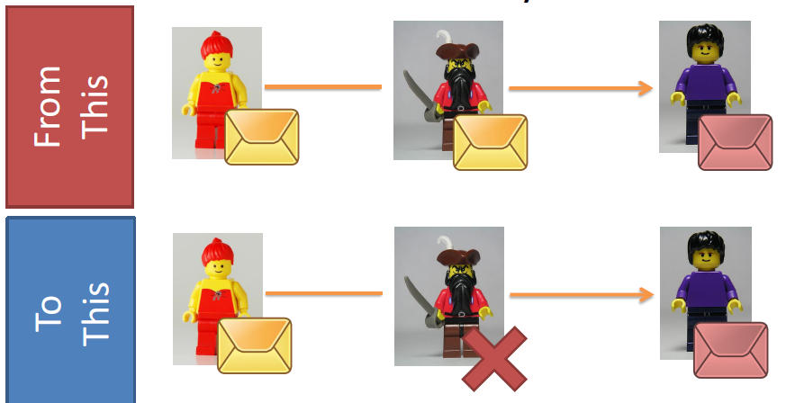
Confidentiality

Slide 20
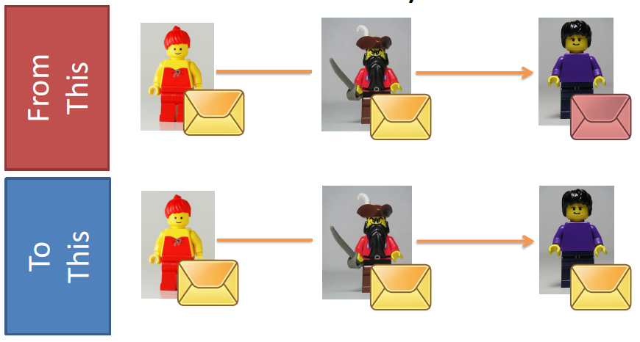
Authenticity/Integrity

Slide 21
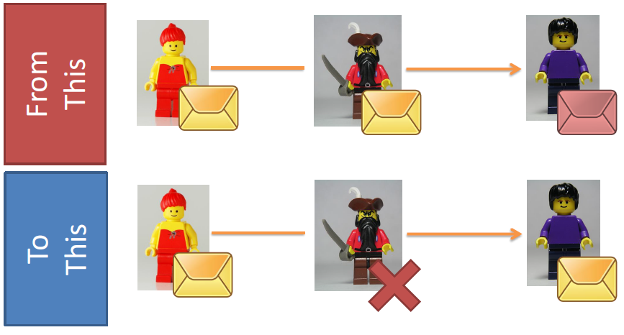
Confidentiality + Authenticity/Integrity

Slide 22
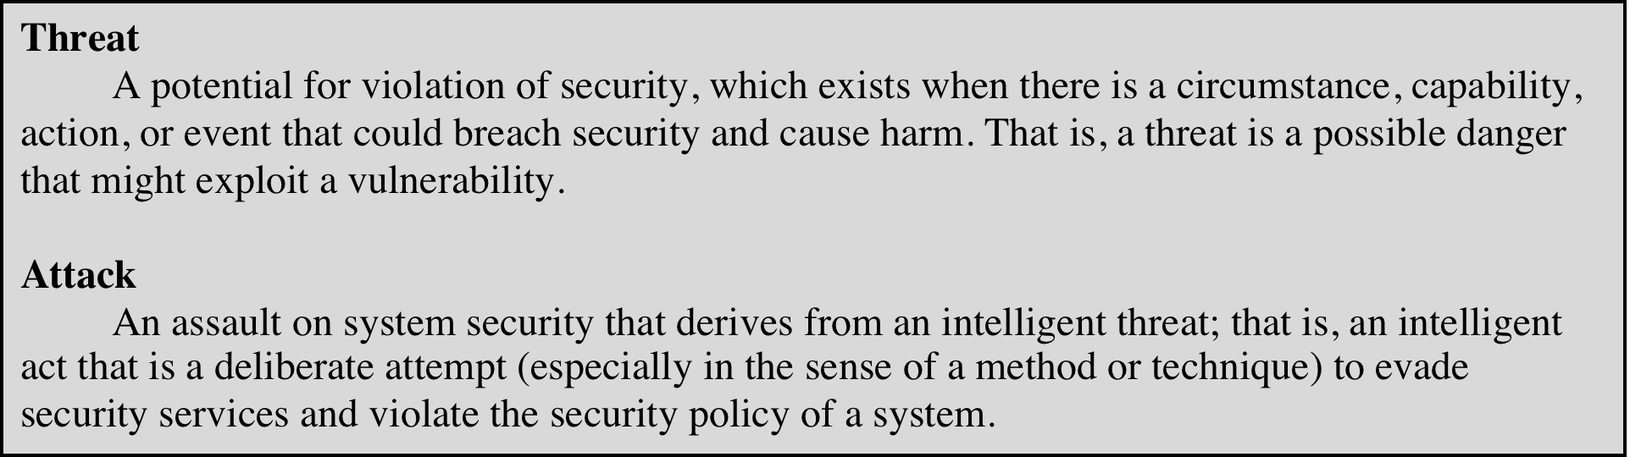
Threats and Attacks (RFC 4949)

Slide 23
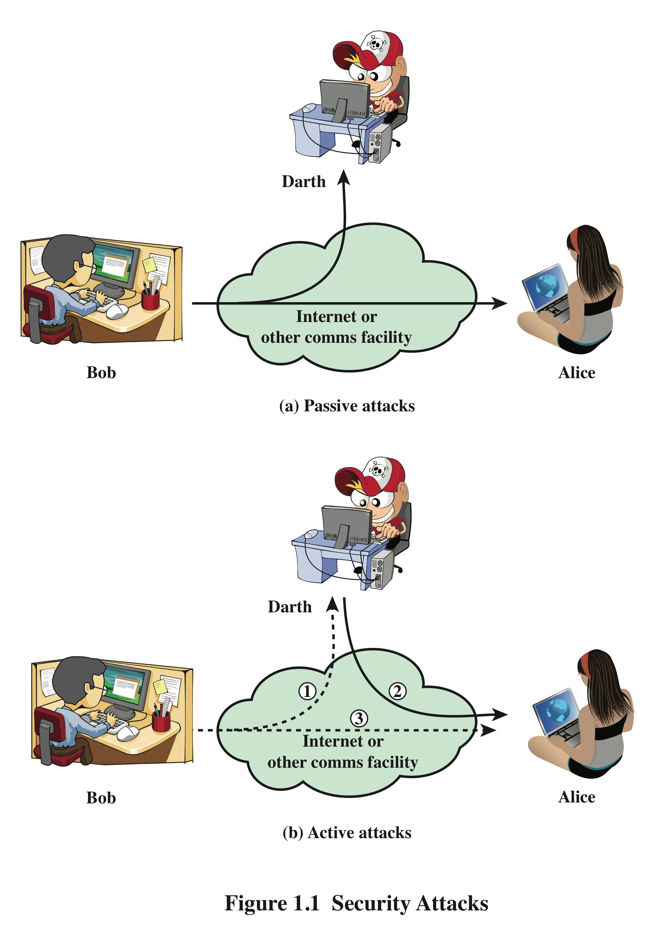
Security Attacks
A means of classifying security attacks, used both in X.800 and RFC 4949, is in terms of passive attacks and active attacks
A passive attack attempts to learn or make use of information from the system but does not affect system resources
An active attack attempts to alter system resources or affect their operation

Slide 24
Passive Attacks
Are in the nature of eavesdropping on, or monitoring of, transmissions
Goal of the opponent is to obtain information that is being transmitted
Two types of passive attacks are:
The release of message contents
Traffic analysis

Slide 25
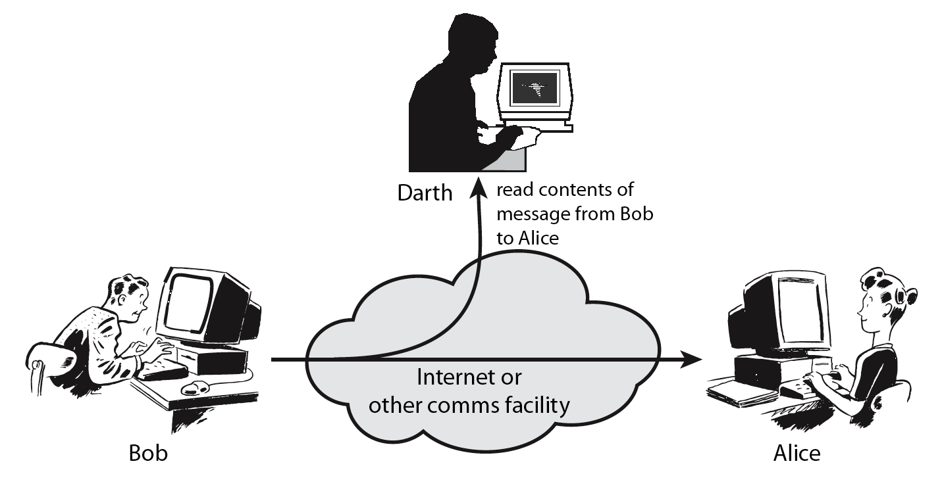
Passive Attack: Release of Message Content/Eavesdropping

Slide 26
Passive Attack: Traffic Analysis
Observe traffic pattern

Slide 27
Active Attacks
Involve some modification of the data stream or the creation of a false stream
Difficult to prevent because of the wide variety of potential physical, software, and network vulnerabilities
Goal is to detect attacks and to recover from any disruption or delays caused by them
Masquerade
Takes place when one entity pretends to be a different entity
Usually includes one of the other forms of active attack
Replay
Involves the passive capture of a data unit and its subsequent retransmission to produce an unauthorized effect
Modification of messages
Some portion of a legitimate message is altered, or messages are delayed or reordered to produce an unauthorized effect
Denial of service
Prevents or inhibits the normal use or management of communications facilities

Slide 28
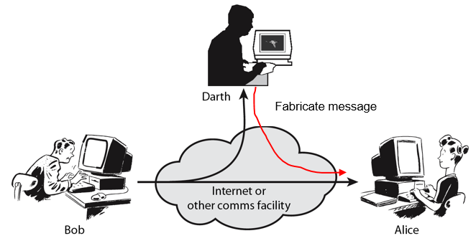
Active Attack: Masquerade

Slide 29
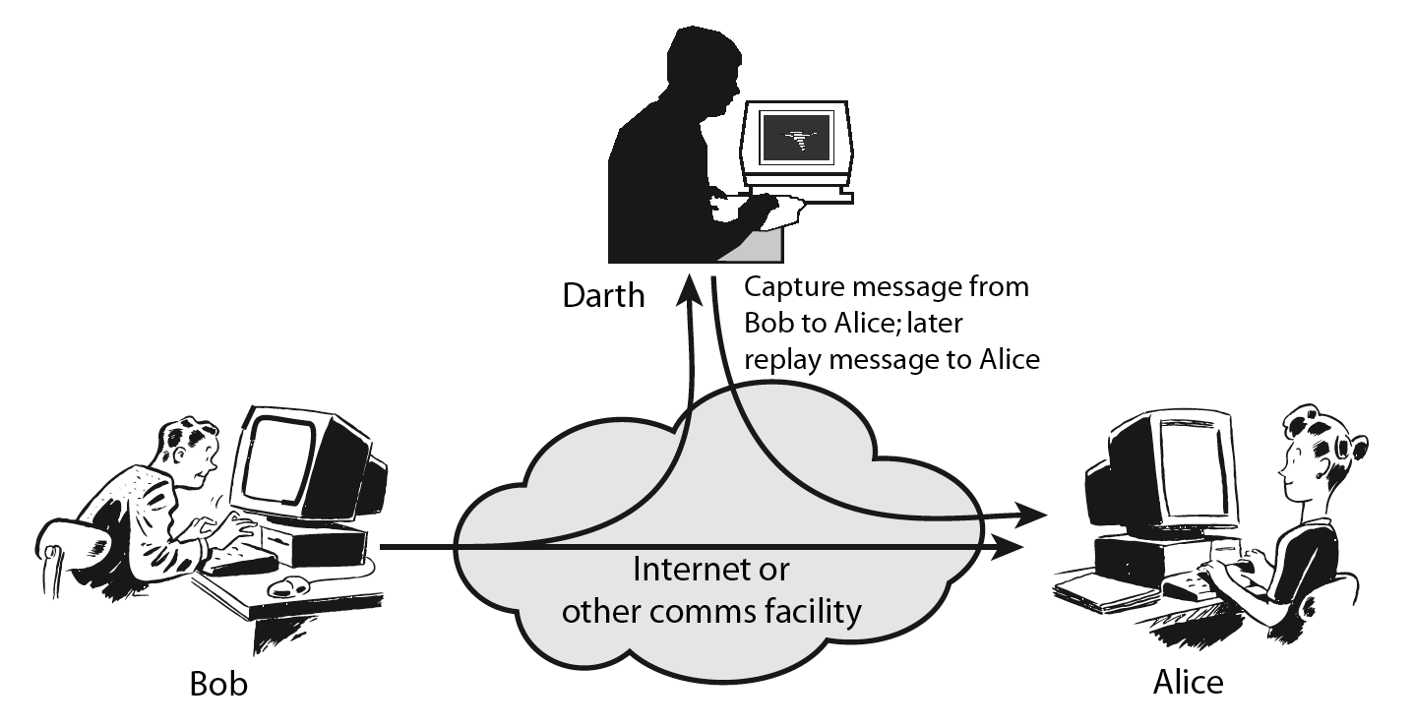
Active Attack: Replay

Slide 30
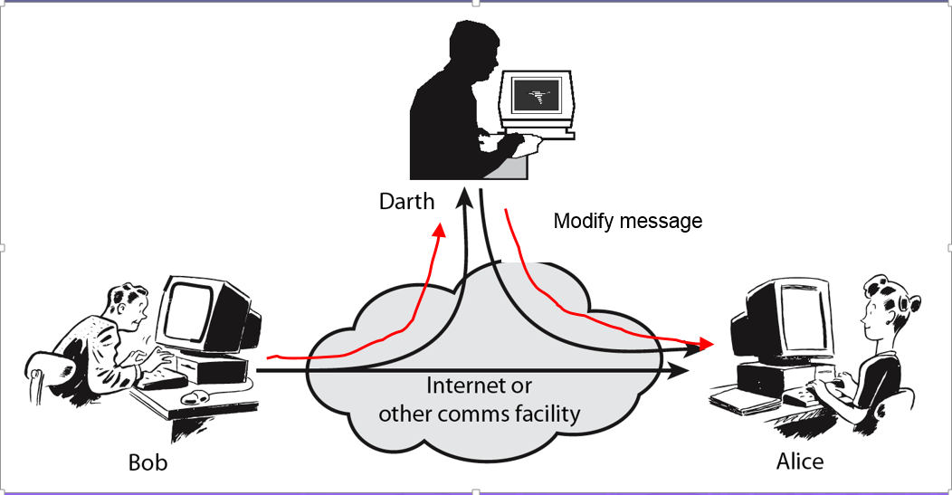
Active Attack: Modification

Slide 31
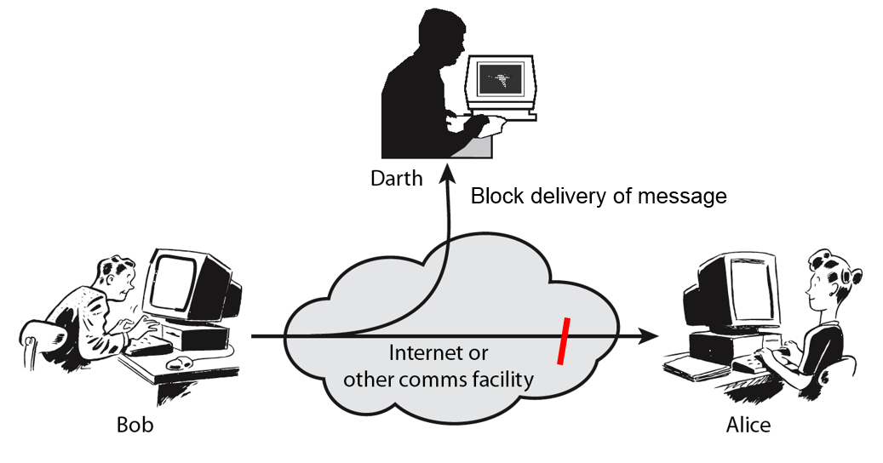
Active Attack: Denial of Service

Slide 32
Basic Terminology
Plaintext
The original message
Ciphertext
The coded message
Enciphering or encryption
Process of converting from plaintext to ciphertext
Deciphering or decryption
Restoring the plaintext from the ciphertext
Cryptography
Study of encryption
Cryptographic system or cipher
Schemes used for encryption
Cryptanalysis
Techniques used for deciphering a message without any knowledge of the enciphering details
Cryptology
Areas of cryptography and cryptanalysis together

Slide 33
Cryptographic Systems
Characterized along three independent dimensions:
The type of operations used for transforming plaintext to ciphertext
Substitution
Transposition
The number of keys used
Symmetric, single-key, secret-key, conventional encryption
Asymmetric, two-key, or public-key encryption
The way in which the plaintext is processed
Block cipher
Stream cipher

